Slide 1
Lecture 4
STREAM CIPHERS

Slide 2
Symmetric Key Crypto
Stream Ciphers and block ciphers are two categories of ciphers used in classical cryptography.
Stream and Block Ciphers differ in how large a piece of the message is processed in each encryption operation.
Stream ciphers encrypt plaintext one byte or one bit at a time.
Block ciphers encrypt a group of plaintext symbols as one block ( encrypt plaintext in chunks).
Notes:
Stream ciphers convert one symbol of plaintext directly into a symbol of ciphertext. Block ciphers encrypt a group of plaintext symbols as one block. Simple substitution is an example of a stream cipher. Columnar transposition is a block cipher.

Slide 3
STREAM CIPHERS
Takes a key K of n bits in length and stretches it into a long keystream.
This keystream is then XORed with the plaintext P to produce ciphertext C.
The use of the keystream is identical to the use of the key in a one-time pad cipher.
To decrypt with a stream cipher, the same keystream is generated and XORed with the ciphertext.
Stream Cipher – encryption of bits
A5/1 , RC4
Inspired by the one time pad (OTP)

Slide 4
STREAM CIPHERS
The function of a stream cipher can be viewed simply as:
StreamCipher(K) = S
where K is the key and S is the keystream that we’ll use like a one-time pad.
The encryption formula is:
c0 = p0 ⊕ s0, c1 = p1 ⊕ s1, c2 = p2 ⊕ s2, . . .
where P = p0p1p2 . . . is the plaintext, S = s0s1s2 . . . is the keystream and C = c0c1c2 . . . is the ciphertext.
To decrypt ciphertext C, the keystream S is again used:
p0 = c0 ⊕ s0, p1 = c1 ⊕ s1, p2 = c2 ⊕ s2, . . . .

Slide 5
A5/1: Shift Registers
A5/1 uses 3 shift registers
X: 19 bits (x₀,x₁,x₂, …,x₁₈)
Y: 22 bits (y₀,y₁,y₂, …,y₂₁)
Z: 23 bits (z₀,z₁,z₂, …,z₂₂)

Slide 6
A5/1: Keystream
At each iteration: m = maj(x₈, y₁₀, z₁₀)
Examples: maj(0,1,0) = 0 and maj(1,1,0) = 1
If x₈ = m then X steps
t = x₁₃ ⊕ x₁₆ ⊕ x₁₇ ⊕ x₁₈
x_{i} = x_{i−1} for i = 18,17,…,1 and x₀ = t
If y₁₀ = m then Y steps
t = y₂₀ ⊕ y₂₁
y_{i} = y_{i−1} for i = 21,20,…,1 and y₀ = t
If z₁₀ = m then Z steps
t = z₇ ⊕ z₂₀ ⊕ z₂₁ ⊕ z₂₂
z_{i} = z_{i−1} for i = 22,21,…,1 and z₀ = t
Keystream bit is x₁₈ ⊕ y₂₁ ⊕ z₂₂

Slide 7
A5/1
X
x₀ | x₁ | x₂ | x₃ | x₄ | x₅ | x₆ | x₇ | x₈ | x₉ | x₁₀ | x₁₁ | x₁₂ | x₁₃ | x₁₄ | x₁₅ | x₁₆ | x₁₇ | x₁₈
⊕
Y
y₀ | y₁ | y₂ | y₃ | y₄ | y₅ | y₆ | y₇ | y₈ | y₉ | y₁₀ | y₁₁ | y₁₂ | y₁₃ | y₁₄ | y₁₅ | y₁₆ | y₁₇ | y₁₈ | y₁₉ | y₂₀ | y₂₁
⊕
⊕
Z
z₀ | z₁ | z₂ | z₃ | z₄ | z₅ | z₆ | z₇ | z₈ | z₉ | z₁₀ | z₁₁ | z₁₂ | z₁₃ | z₁₄ | z₁₅ | z₁₆ | z₁₇ | z₁₈ | z₁₉ | z₂₀ | z₂₁ | z₂₂
⊕
Each variable here is a single bit
Key is used as initial fill of registers
Each register steps (or not) based on maj(x₈, y₁₀, z₁₀)
Keystream bit is XOR of rightmost bits of registers

Slide 8
A5/1
X
1 | 0 | 1 | 0 | 1 | 0 | 1 | 0 | 1 | 0 | 1 | 0 | 1 | 0 | 1 | 0 | 1 | 0 | 1
⊕
Y
1 | 1 | 0 | 0 | 1 | 1 | 0 | 0 | 1 | 1 | 0 | 0 | 1 | 1 | 0 | 0 | 1 | 1 | 0 | 0 | 0 | 1
⊕
⊕
Z
1 | 1 | 1 | 0 | 0 | 0 | 0 | 1 | 1 | 1 | 1 | 0 | 0 | 0 | 0 | 1 | 1 | 1 | 1 | 0 | 0 | 0 | 1
⊕
In this example, m = maj(x₈, y₁₀, z₁₀) = maj(1,0,1) = 1
Register X steps, Y does not step, and Z steps
Keystream bit is XOR of right bits of registers
Here, keystream bit will be 0 ⊕ 1 ⊕ 0 = 1

Slide 9
Example
Implement the A5/1 algorithm. Suppose the values in the registers are
X = (x0, x1, . . . , x18) = (1010101010101010101)
Y = (y0, y1, . . . , y21) = (1100110011001100110011)
Z = (z0, z1, . . . , z22) = (11100001111000011110000)
Generate and print the next 32 keystream bits. Print the contents of X, Y and Z after the 32 keystream bits have been generated

Slide 10
Example
X = (x0, x1, . . . , x18) = (10 10 10 10 10 10 10 10 10 1)
Y = (y0, y1, . . . , y21) = (11 00 11 00 11 00 11 00 11 00 11)
Z = (z0, z1, . . . , z22) = (11 10 00 01 11 10 00 01 11 10 00 0)
M= maj(x8,y10,z10)
M=maj(1,0,1)=1

Slide 11
Example
For register x
Compare x8=1 with m =1 they are equal then do step
T_{x}=x₁₃ ⊕ x_{16 ⊕} x_{17 ⊕} x₁₈
T_{x}=0 ⊕ 1 ⊕ 0 ⊕ 1, T_{x} =0
X = (T_{x},,x0, x1, . . . , x17) = (0 10 10 10 10 10 10 10 10 10)

Slide 12
Example
For register y
Compare y₁₀=0 with m =1 they are not equal then do not do step
Y = (y0, y1, . . . , y21) = (11 00 11 00 11 00 11 00 11 00 11)
For register z
Compare z₁₀=1 with m =1 they are equal then do step
T_{z}= z₇ ⊕ z₂₀ ⊕ z₂₁ ⊕ z₂₂
T_{z}= 1⊕ 0 ⊕ 0 ⊕ 0 = 1
Z = (T_{z}, z0, z1, . . . , z21) = (1 11 10 00 01 11 10 00 01 11 10 00)
Keystream bit is x₁₈ ⊕ y₂₁ ⊕ z₂₂ = 0 ⊕1 ⊕ 0 =1

Slide 13
RC4
A self-modifying lookup table
Table always contains a permutation of the byte values 0,1,…,255
Initialize the permutation using key
At each step, RC4 does the following
Swaps elements in current lookup table
Selects a keystream byte from table
Each step of RC4 produces a byte
Efficient in software
Each step of A5/1 produces only a bit
Efficient in hardware

Slide 14
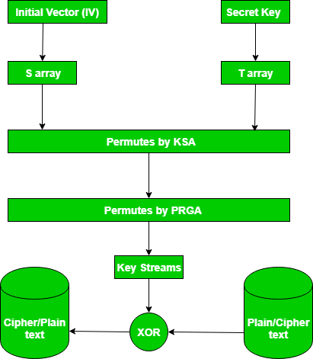
RC4
Notes:
Key Scheduling Algorithm
Pseudo Random Generation Algorithm

Slide 15
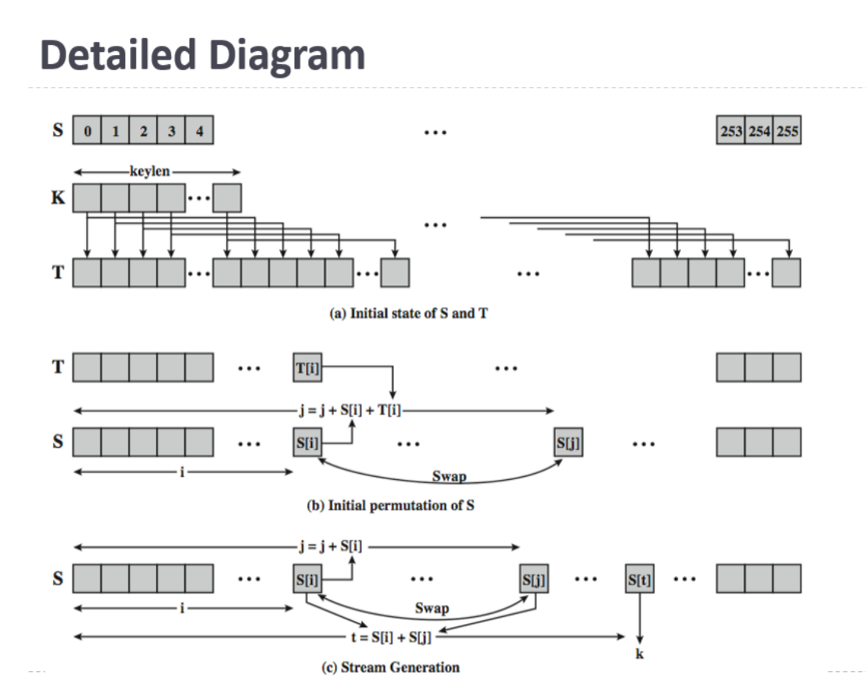

Slide 16
RC4 Initialization
S[] is permutation of 0,1,...,255
key[] contains N bytes of key
for i = 0 to 255
S[i] = i
T[i] = key[i (mod N)]
next i
j = 0
for i = 0 to 255
j = (j + S[i] + T[i]) mod 256
swap(S[i], S[j])
next i
i = j = 0

Slide 17
RC4 Keystream
At each step, swap elements in table and select keystream byte
i = (i + 1) mod 256
j = (j + S[i]) mod 256
swap(S[i], S[j])
t = (S[i] + S[j]) mod 256
keystreamByte = S[t]
Use keystream bytes like a one-time pad

